Slide 1

Software Engineering
Introduction to Software Engineering
Requirement Engineering
Acknowledgement: Authors of the prescribed textbooks and materials sourced online.

Slide 2

Requirements Engineering
List of Contents
Requirements Engineering - Introduction
Cost of Repair as a Function of Time
Defining a Requirement
Properties of Requirement
Properties of a Set of Requirement
Feasibility Study
Requirement Engineering Process

Slide 3
Requirements Engineering
Requirement is the property which must be exhibited by software developed/adapted to solve a particular problem.
Requirement should specify the externally visible behavior of what and not how.
Requirement
Individual requirements
Set of requirements
REQUIREMENTS ENGINEERING
First step in any software intensive development lifecycle irrespective of model
Difficult, error prone and costly
Critical for successful development of all down stream activities
Requirement errors are expensive to fix

Slide 4
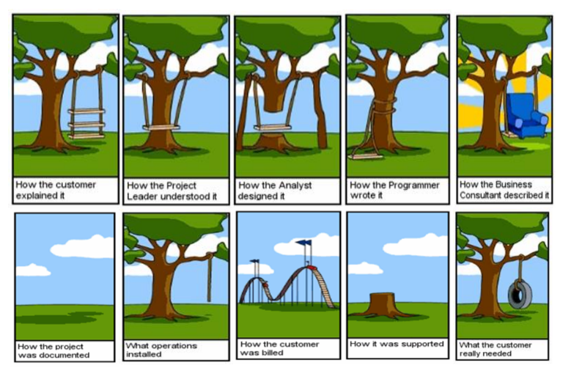
Parody!

Slide 5
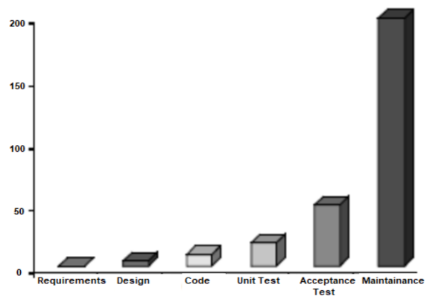
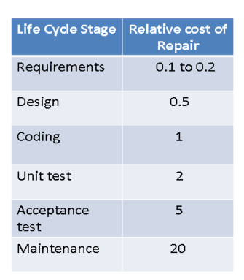
Cost of repair as a function of time

Slide 6
Definition of Requirement
Requirement is the Property which must be exhibited by software developed/adapted to solve a particular problem
Requirement should specify the externally visible behavior of what and not how
Requirements can be looked at as
Individual requirements
Set of requirements

Slide 7
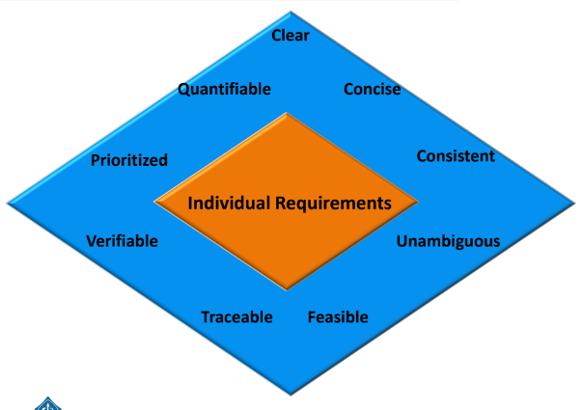
Properties of Requirement
Concise – Requirements should describe a single property
Unambiguous – Requirement should have only one interpretation
Verifiable – Requirement must have a clear, testable criterion and a cost-effective process to check it has been realized as
requested

Slide 8
Properties of Requirement contd.
Quantifiable – Requirement should be quantifiable
Consistent – No requirement should contradict another
Traceable – Backwards to stakeholder request and forward to software components
Feasible – Realizable with a specified time frame
Clear – Written precisely
Prioritized – Requirement should be prioritized

Slide 9
Requirements Engineering – In-Class Exercises
Use the properties of requirement to transform the given sentences into requirements.
All screens must appear quickly on the monitor
When the user accesses any screen, it must appear on the monitor within 2 seconds (Clear, Concise, Unambiguous, Verifiable, Measurable)
The replacement control system shall be installed with no disruption to production
The replacement control system shall be installed causing no more than 2 days of
production disruption (Feasible)
The system must generate a batch end report and a discrepancy report when a batch is aborted
The system must generate a batch end report when a batch is completed or aborted
The system must generate a discrepancy report when a batch is aborted (Traceable)
The system must be user friendly
The user interface shall be menu driven. It shall provide dialog boxes, help screens,
radio buttons, dropdown list boxes, and spin buttons for user inputs (Verifiable)

Slide 10
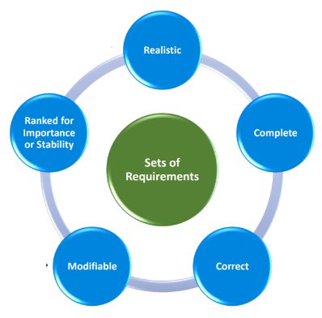
Properties of a Set of Requirements
When there are many requirements but limited
time or budget, choices must be made about
which to include or exclude. Factors such as:
changes in customer needs
improved developer understanding of the products
changes in organizational policy
will affect the stability of requirements.

Slide 11
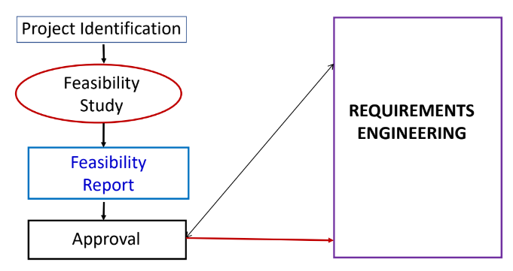
Feasibility Study
What is Feasibility Study?
Short, low-cost study to assess the practicality of the project and whether it should be done
When is Feasibility Study conducted?
Mostly done before beginning a project
ACTIVITIES IN FEASIBILITY STUDY
Figure out the client or the sponsor or the user who would have a stake in the project
Find the current solution to the problem
Find the targeted customers and the future market place
Potential benefits
Scope
High level block level understanding of the solution
Considerations to technology
Marketing strategy
Financial projection
Schedule and high level planning and budget requirements
Issues, assumptions, risks and constraints
Alternatives and their consideration
Potential project organization
Ends with GO or NO-GO

Slide 12
Feasibility Study — Types
Technical feasibility — determines whether the team has enough tech and human resources to turn the client’s expectations into operational systems.
Operational feasibility — stands for both how easy it will be to operate the product after its deployment and how the organization’s operational goals intertwine with the project in question.
Economic feasibility — requires a cost/benefit assessment that includes the analysis of short, middle, and long-term gains or risks associated with the project.
Legal feasibility — covers all legal aspects of the project (zoning, data collection and security, etc.) at any stage of its realization.
Scheduling feasibility — determines the time required to complete the project and its compliance with the deadline previously agreed on by the client.

Slide 13
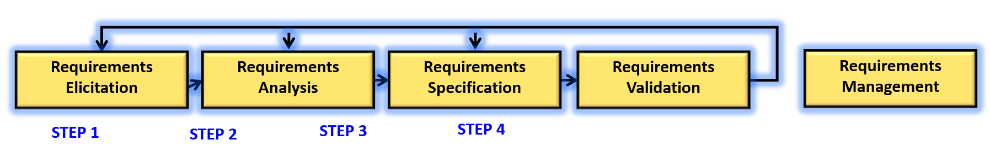
Requirements Engineering Process
A “four + one” set of activities to produce specifications or requirements
It is an iterative process
Requirements Elicitation – To gather and discover requirements
Requirements Analysis – Process of reviewing requirements

Slide 14
Requirements Engineering Process contd.
A “four + one” set of activities to produce specifications or requirements
It is an iterative process
Requirements Specifications – Process of creating software and system specification documents suitable for further designing and maintenance
Requirements Validation – Helps ensure the right requirements are realized

Slide 15
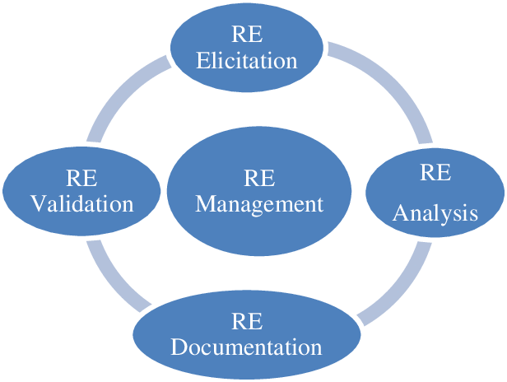
Requirements Engineering Lifecycle
Requirements Engineering : https://www.geeksforgeeks.org/software-engineering-requirements-engineering-process/

Slide 16

Real Life Importance of Requirements Engineering
Case Study : Restaurant Menu Design
Scenario: A restaurant wants to redesign its menu to improve customer satisfaction and increase sales.
Compare the outcomes of a project with and without requirements engineering. How do clear requirements contribute to project success?
Why is it crucial to invest time and resources into requirements engineering, even if it seems like a time-consuming process?

Slide 17
Continuation
With Requirements Engineering:
Requirements Gathering: The restaurant surveys customers, analyzes sales data, and consults with staff to gather insights on popular dishes, dietary preferences, and pricing.
Requirements Analysis: They analyze the data to determine which dishes should be highlighted, which items need improvement, and what new items to introduce.
Requirements Specification: The team documents the desired changes, including menu layout, dish descriptions, and pricing.
Design and Implementation: The new menu design is created based on the documented requirements.
Validation: The menu is tested with a sample of customers to ensure it meets their preferences and improves sales.

Slide 18
Continuation
Pros:
Targeted Changes: The menu changes are based on actual customer feedback and data, leading to more effective improvements.
Increased Sales: A well-designed menu can lead to increased sales and customer satisfaction.
Better Planning: The design and implementation process is guided by clear requirements, reducing the risk of costly revisions.
Cons:
Initial Investment: Gathering and analyzing data can require an initial investment of time and resources.
Potential Overemphasis: Focusing too much on specific requirements may overlook broader trends or innovations.

Slide 19
A simple real life case study
Without Requirements Engineering:
Process:
Menu Redesign Begins: The chef and staff make changes to the menu based on personal preferences and assumptions.
Changes Made: New dishes are added and existing ones are adjusted without consulting customer feedback.
Implementation: The new menu is printed and introduced without testing.
Pros:
Quick Decisions: The redesign process is faster and driven by internal ideas.
Creative Freedom: The chef and staff have the freedom to experiment and implement creative ideas.
Cons:
Missed Opportunities: The changes may not align with customer preferences or market trends.
Ineffective Changes: The menu redesign may not achieve the desired impact on sales or customer satisfaction.
Limited Feedback: Lack of testing means there’s no assurance that the new menu will be well-received.

Slide 20
THANK YOU

